Slide 1
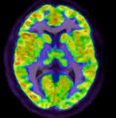
Physical Changes to the Brain with PTSD
Loving My Veteran
Walking In My Shoes

Slide 2
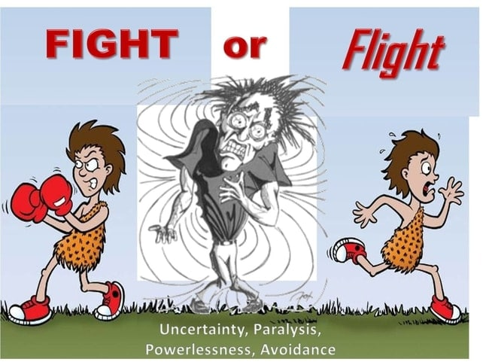
Danger, Danger, Danger!
PTSD causes the brain to get stuck in danger mode. It is commonly called “fight or flight”.

Slide 3
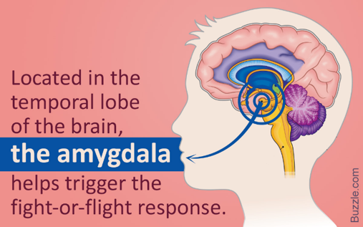
Amygdala
Small almond shaped area of the brain. Found on both the right and left side of the brain.
When the body perceives danger the Amygdala sets off an alarm that warns the body that it may be in danger.
It prepares your body to respond, fight or flight. It also triggers other areas of the brain to respond. Your brain then decides to stay on alert or calm down.

Slide 4
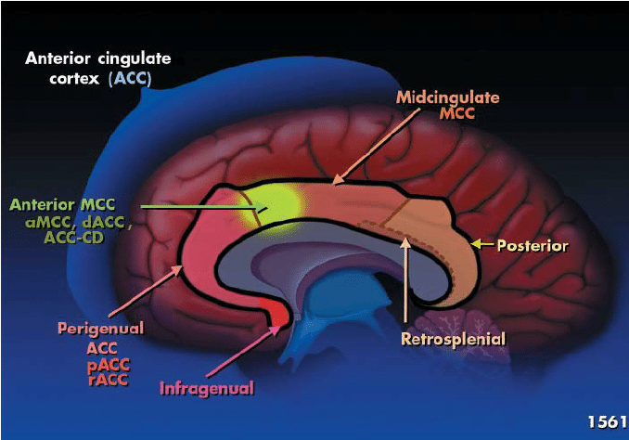
Mid-anterior cingulate Cortex
Middle part of the anterior cingulate cortex. In the photo it is to the left of the area in yellow.
It reduces pain when the body has an initial pain response. It is what causes the body not to initially feel severe pain, following an accident or a broken bone.

Slide 5
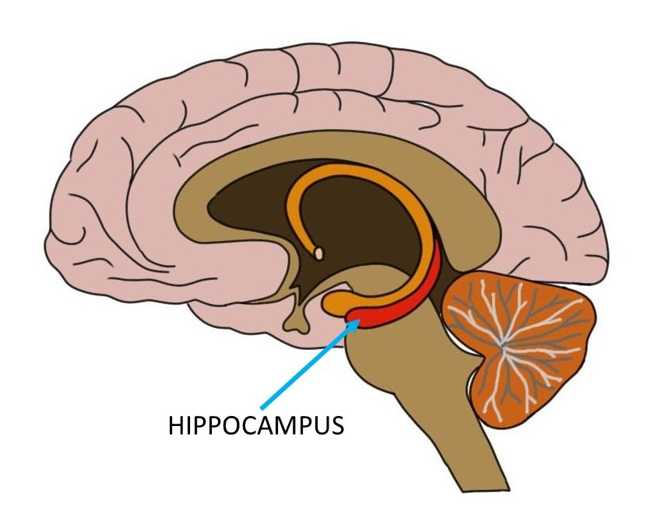
Hippocampus
It the part of the brain that is responsible for long-term memory.
During fight or flight the hippocampus initiates the signal to the rest of the brain to get the body to calm down.

Slide 6
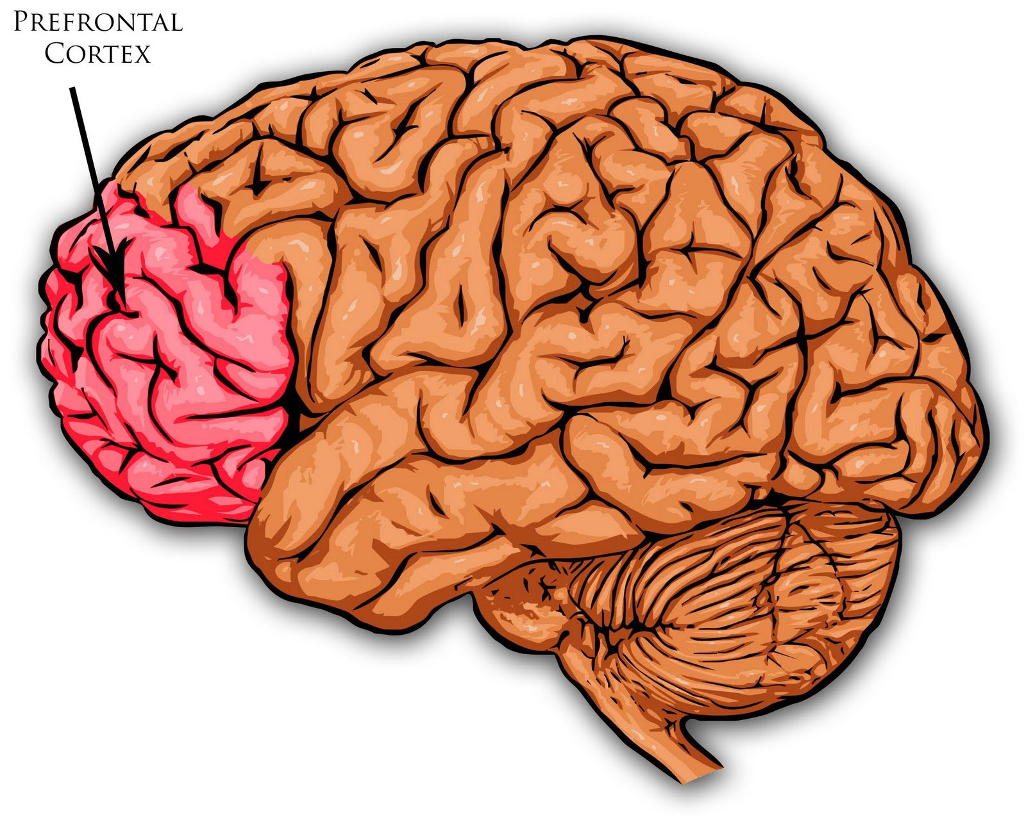
Prefrontal Cortex (PFC)
The prefrontal cortex (PFC) is the cerebral cortex covering the front part of the frontal lobe. This brain region has been implicated in planning complex cognitive behavior, personality expression, decision making, and moderating social behavior.

Slide 7
What happens to the ptsd brain
Hyperactive
Hypoactive
Amygdala
Mid-anterior cingulate cortex
Hippocampus
Right inferior frontal gyrus
Prefrontal Cortex (PFC)
Orbital cortex

Slide 8
PTSD – Repeated Trauma
When the brain is exposed to trauma or traumatic event over and over the amygdala becomes hyperactive and cannot shut down effectively. This is caused by various factors.
Multiple traumatic events
An emotional event that was forced to be suppressed without having time to deal with it.
Traumatic events that resulted in death, injury or destruction
Blaming yourself for death or injury to others.
PTSD is like being in a constant state of Fight or Flight

Slide 9
Role of Amygdala during non-fight or Flight Moments
Sex – desiring too much or none
Assessment of threat related stimuli
Assessing what in the environment is considered a danger
Fear conditioning
Formation and storage of emotional memories
Memory consolidation
Since these are in a hyperactive state, we might be able to answer some questions.

Slide 10
Role of PFC during non-fight or Flight Moments
Emotional regulation
Initiating voluntary, conscious behaviors
Regulating attention
Decision making
Interpreting emotions
Allowing deep sleep
Since these are in a hypoactive state, we might be able to answer some questions.

Slide 11
PTSD produces physical changes to the brain
More in this series:
Digging Deeper Into the Physical Changes that are often mistaken for Mental Illness
Treatment Options Available
Copyright Loving My Veteran and Walking in My Shoes 2020

